Slide 1

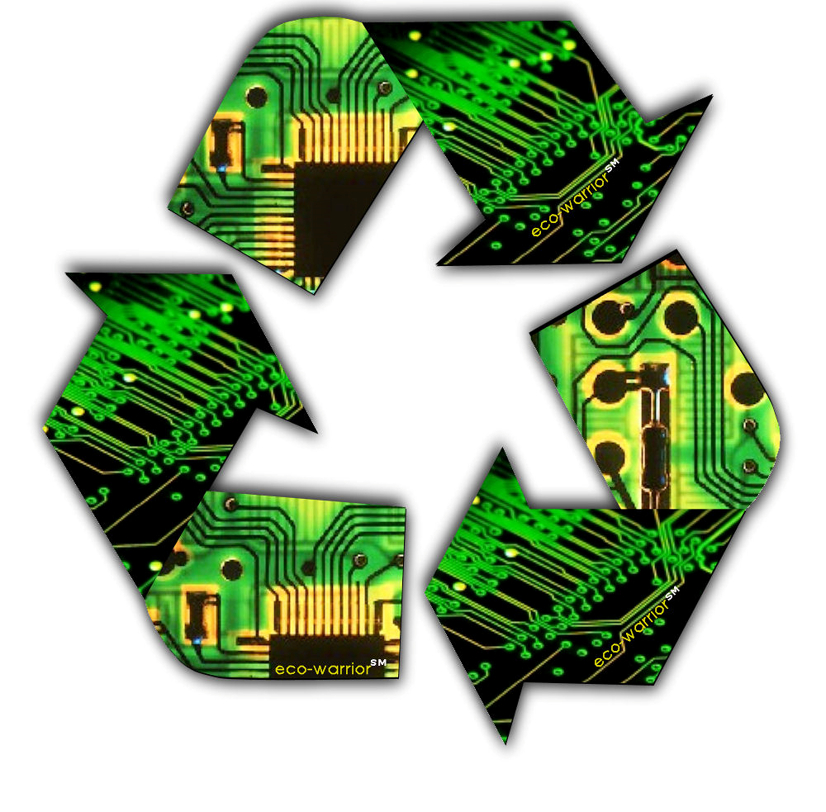

Electronic Waste
1
This Photo by Unknown Author is licensed under CC BY-SA-NC

Slide 2

Introduction to E-Waste
What is E-Waste?
E-waste, or electronic waste, refers to discarded electrical or electronic devices. This waste includes broken, outdated, or unwanted electronics such as smartphones, computers, TVs, refrigerators, batteries, and other electrical gadgets. These devices often contain harmful substances like lead, mercury, and cadmium, making e-waste a significant environmental issue. Proper disposal, recycling, and treatment of e-waste are necessary to prevent environmental harm and health risks.
Types of E-Waste:-
Consumer Electronics
Home Appliances
Computing Equipment
Telecommunication Equipment
Electronic Components
Lighting Equipment
Medical Equipment
2

Slide 3
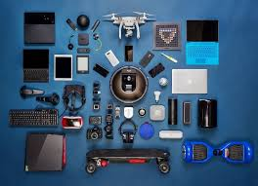

Consumer Electronics
Consumer electronics are electronic devices typically used for leisure purposes or in homes, such as televisions, game consoles, mobile phones, computer hardware/software, digital cameras/camcorders, audio equipment (such as MP3 players), fax machines and home appliances like washing machines and dishwashers.
3

